Slide 1
MSAS Tutorial Sequence -Module One-
WRITTEN BY ADVAY MUCHOOR

Slide 2

WELCOME
TO
MSAS

Slide 3
What is MSAS?
Designed to introduce you to the world of sports analytics
Give you the opportunity to learn and apply essential skills
Network with other students that have similar interests as you
Work with experienced leaders and faculty members
Get hands-on experience with real data
Talk sports!

Slide 4
What is the point of these tutorials?
Get you set up with a familiar environment
Provide you with a foundation that you may not learn in the classroom
Teach you what you need to know in order to get started on a research project

Slide 5
Who am I?

Slide 6
Goals of Today
Install Anaconda (Mandatory)
General Questions
Set up GitHub Account (Optional)
Set Up Your Command Line

Slide 7
Installing Anaconda
https://www.anaconda.com/distribution/#download-section
Select your OS
Select the 64-bit graphical installer for Python 3.7
If you already have the 2.7 version installed, you can keep it installed, but be wary that this tutorial sequence is designed for the 3.7 version
The rest of the guide will contain screenshots from the MacOS and Windows Installation Guides. If you have any issues, please let me or one of the other leadership members know

Slide 8
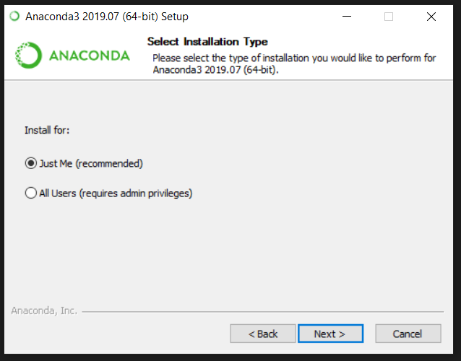
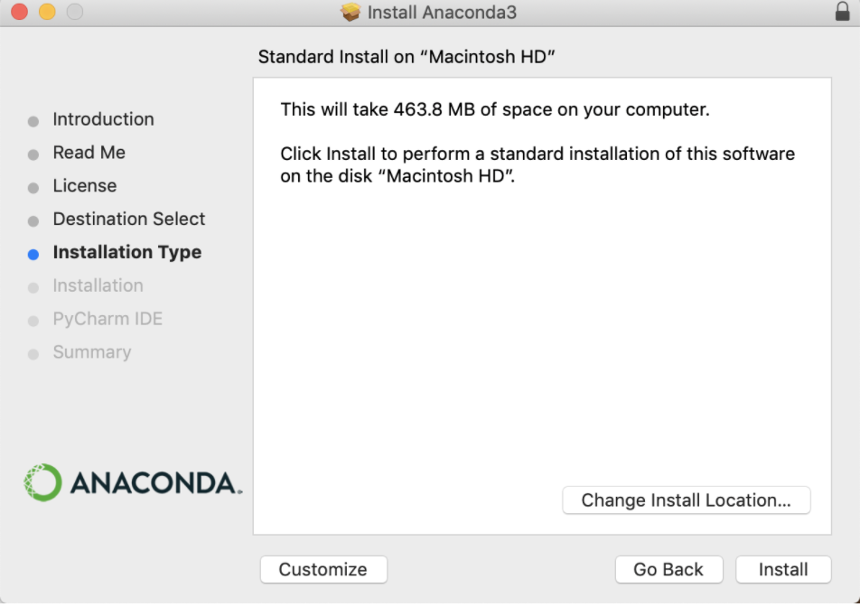

Slide 9
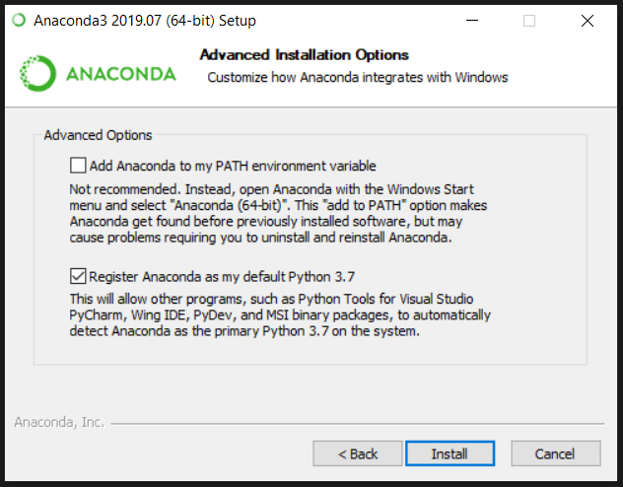
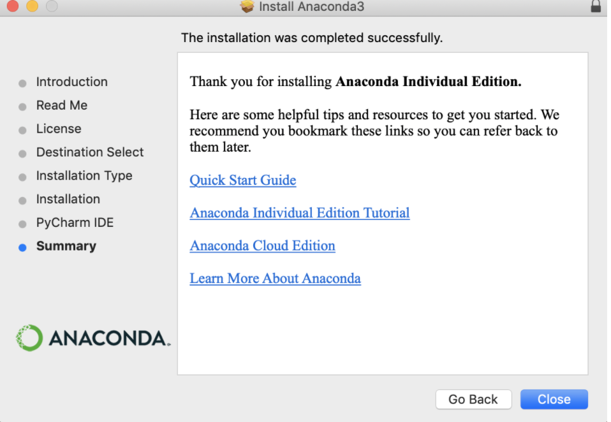

Slide 10
Questions about the club?

Slide 11
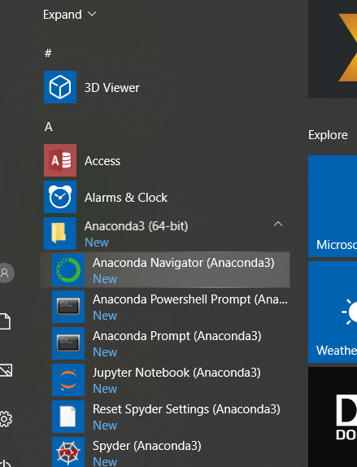
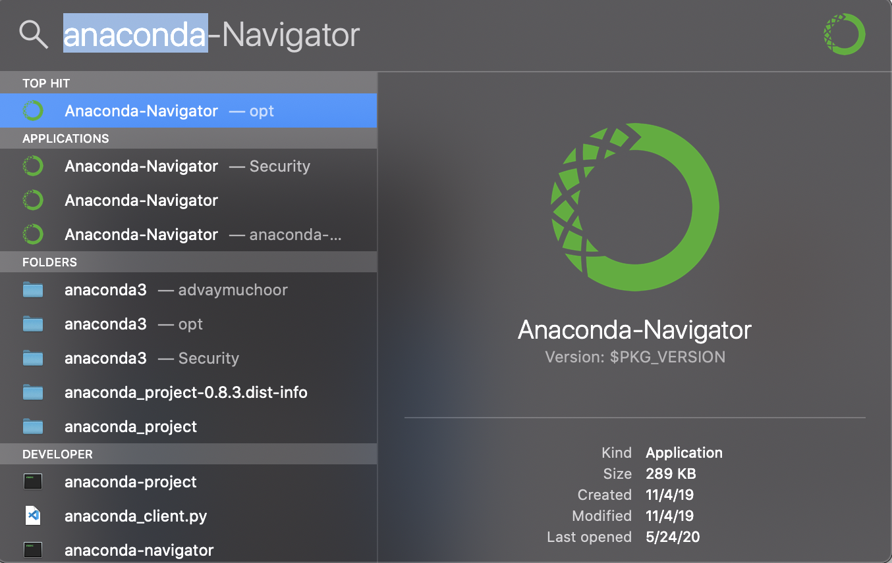
Command + SPACE

Slide 12
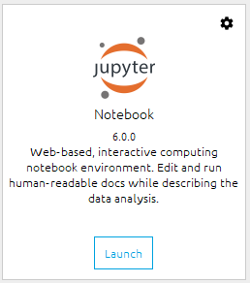

Slide 13
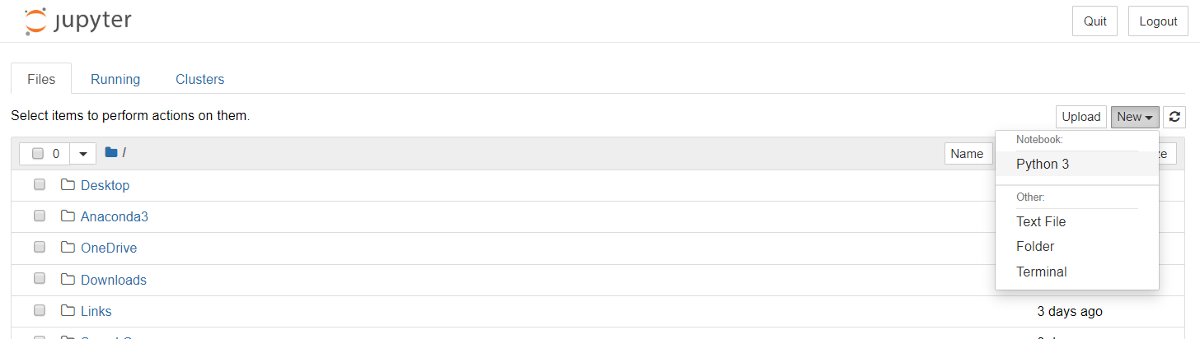

Slide 14
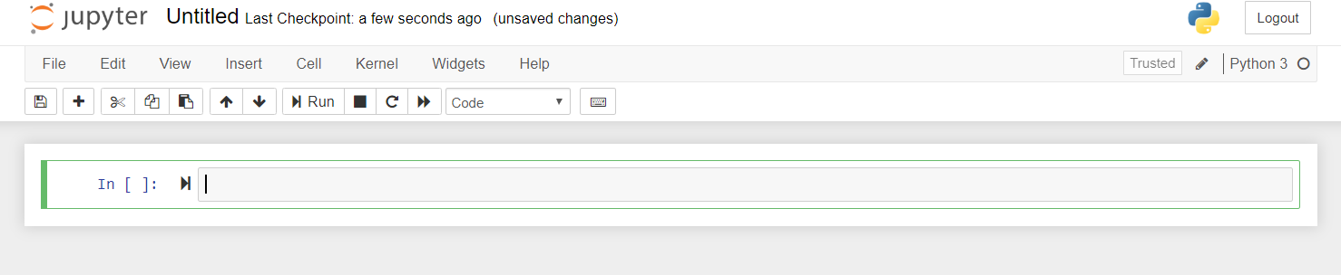
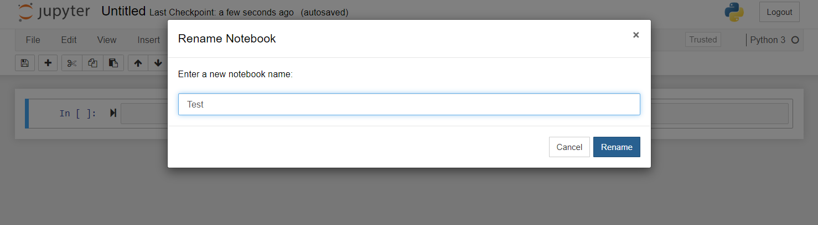

Slide 15
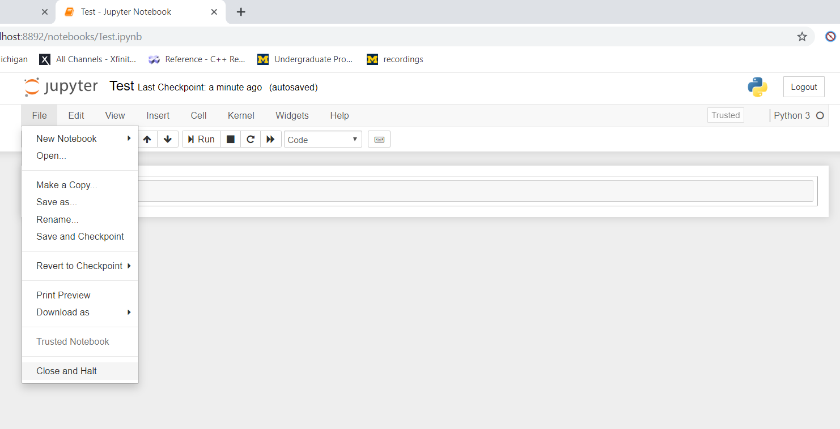
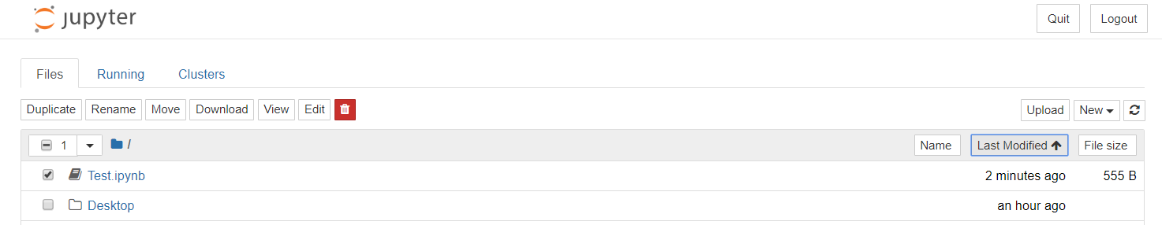

Slide 16
More on Jupyter Notebooks Next Week…

Slide 17

Why You Should Set Up a GitHub Account
GitHub is a free code-sharing platform that allows for multiple collaborators and version control using Git
GitHub is a great way to showcase work that you’ve already done and will do in the future
Everyone who codes should know how Git works – you’ll probably use it (or something similar) some day
Great skill to have on your resume
It’s fast and easy to set up
They have a cool logo (Octocat)

Slide 18
Setting Up Your Account
Sign up at https://github.com/
I would advise against using your school email
You can change the account email at any time
Select the “Free” tier membership

Slide 19
Setting Up Your Command Line (Mac)
1. Install Brew (skip to step 4 if this is already done)
/usr/bin/ruby -e "$(curl –fsSL https://raw.githubusercontent.com/Homebrew/install/master/install)"
2. Hit Return (or escape to cancel)
3. Enter your system password
4. Install git
brew install git
git config --global user.name “First Last”
git config --global user.email “your email”

Slide 20
Setting Up Your Command Line (Windows)
EECS 183 has you covered! Follow the guidelines you see on this walkthrough:
https://eecs183.org/docs/git_on_windows/
Configurate your environment:
git config --global user.name “First Last”
git config --global user.email “your email”

Slide 21
Congrats on Finishing Your First Module!

